Slide 1
Automated Meeting Room Booking System
Enhancing Productivity Through Seamless Room Management

Slide 2
CONTENTS
01
02
Introduction
The Team
03
04
Home Page
Login Page
05
06
Manager Page
Admin Page
07
08
Member Page
Create Room
09
10
Organize Meeting
Book Meeting & Edit Meeting
11
View Meeting

Slide 3
INTRODUCTION
Introducing HavenHive – an Automated Meeting Room Booking System designed to streamline the management of meeting spaces in your organization. HavenHive automates room bookings, provides role-based access, and ensures seamless scheduling for Admins, Managers, and Members. With features like credit management and customizable room settings, HavenHive simplifies the booking process, boosting productivity and collaboration across your teams.

Slide 4
TEAM MEMBERS
Kartik Gupta
Keyur Oak
Pragun Naik
Rishu Jha
Shivansh Sahai
Vaidehi Belsare
Vanshika Sharma

Slide 5
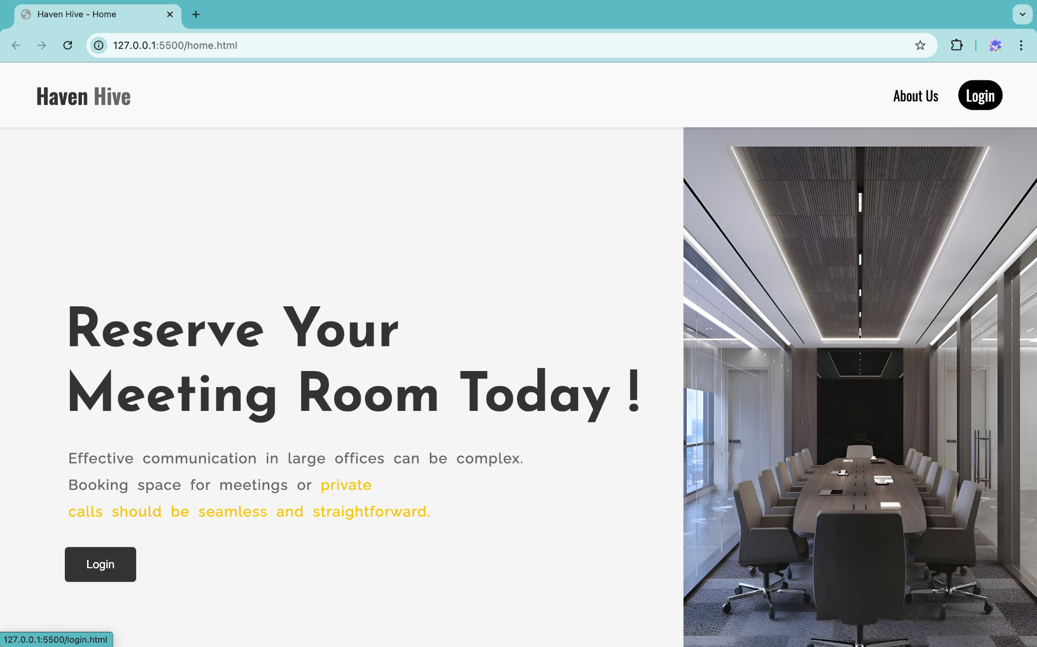
HOME PAGE
The home page has the following cards which allow the users to easily navigate and select the type of service they need.
Classroom Training
Online Training
Conference Call
Business Meetings

Slide 6
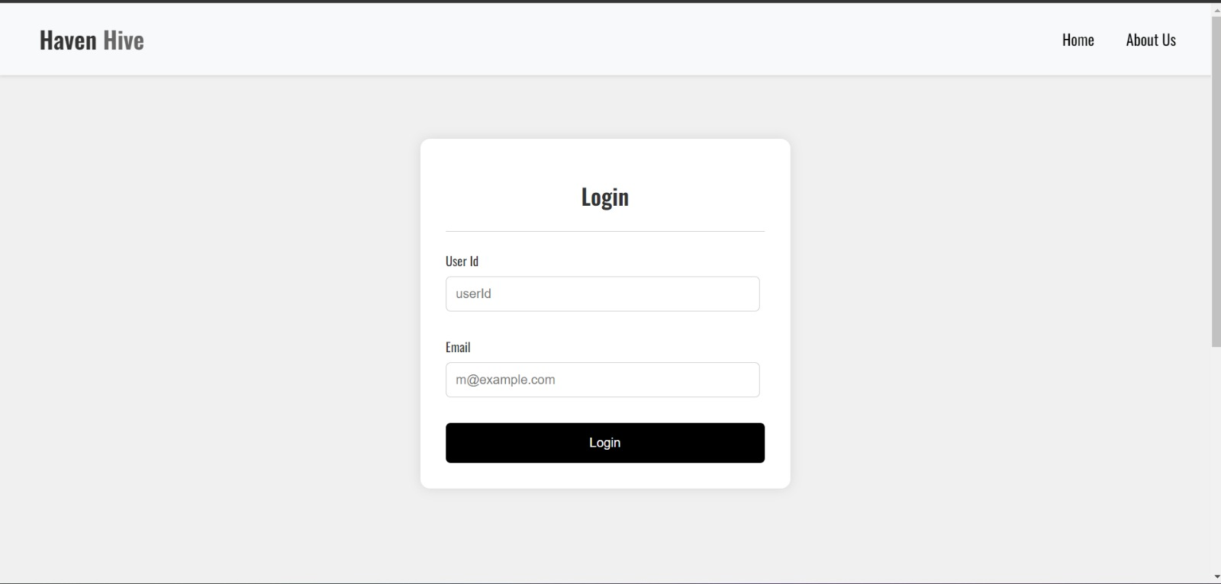
LOGIN PAGE
Users can log in as Admin, Manager, or Member.
Role-based access determines what the user can do within the system.

Slide 7
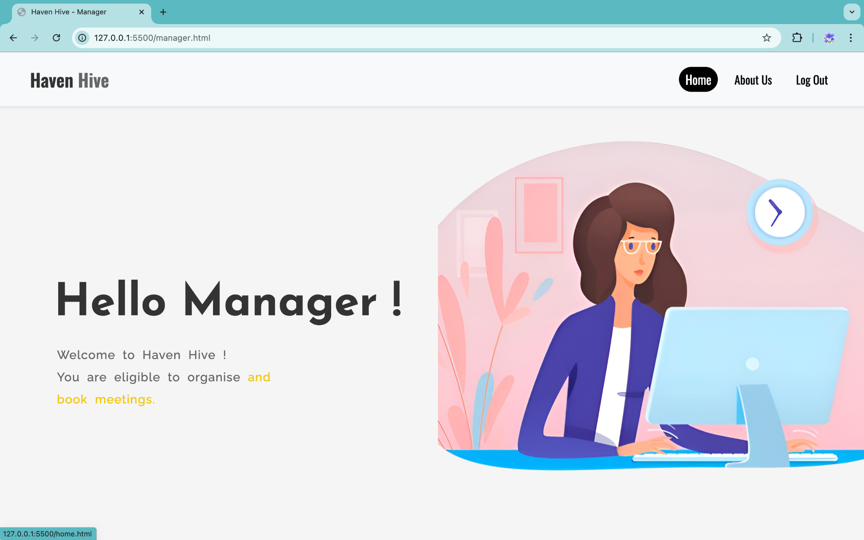
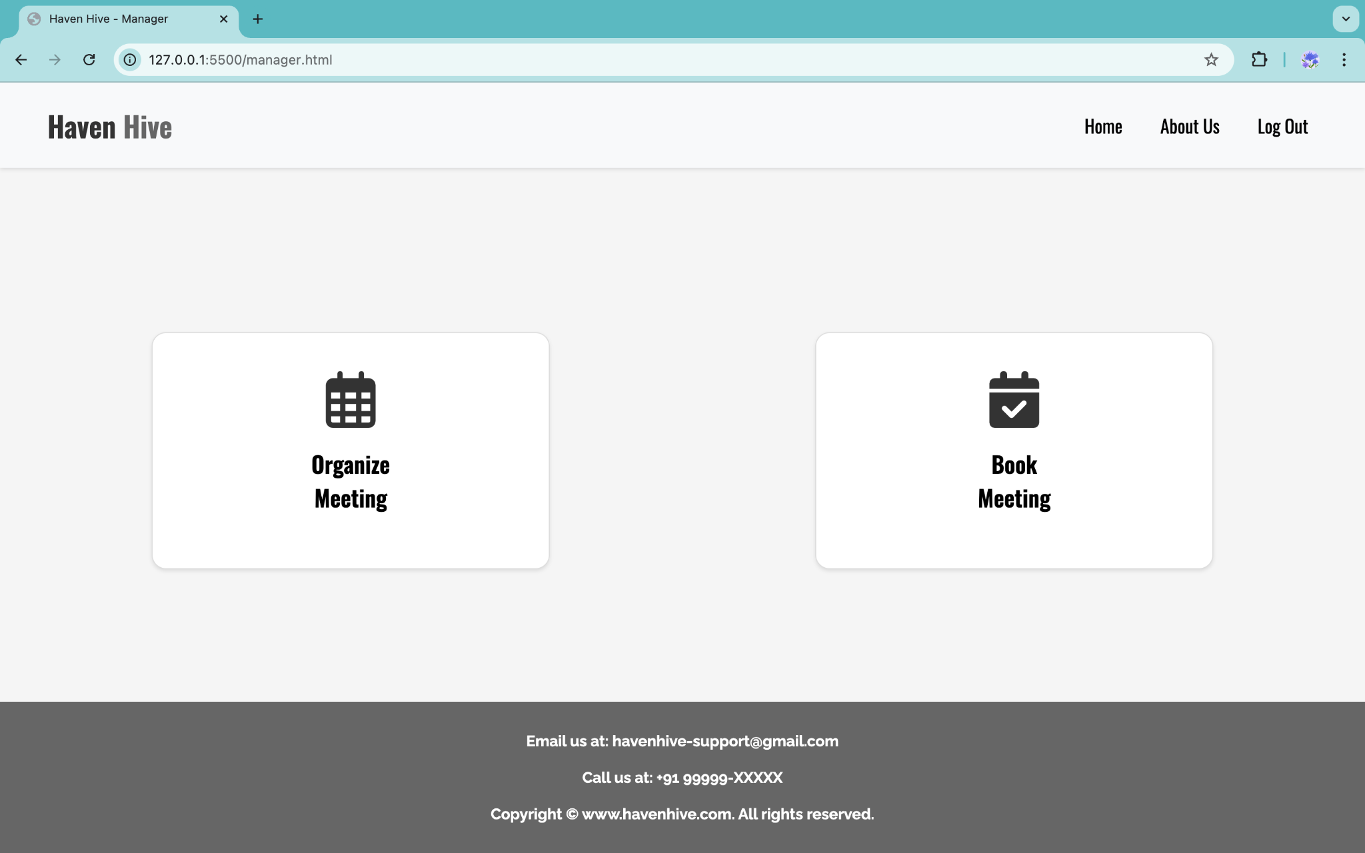
MANAGER PAGE
Manager Dashboard
Organize Meeting: Set up new meetings with required amenities.
Book Meeting: Reserve rooms with real-time credit updates.

Slide 8
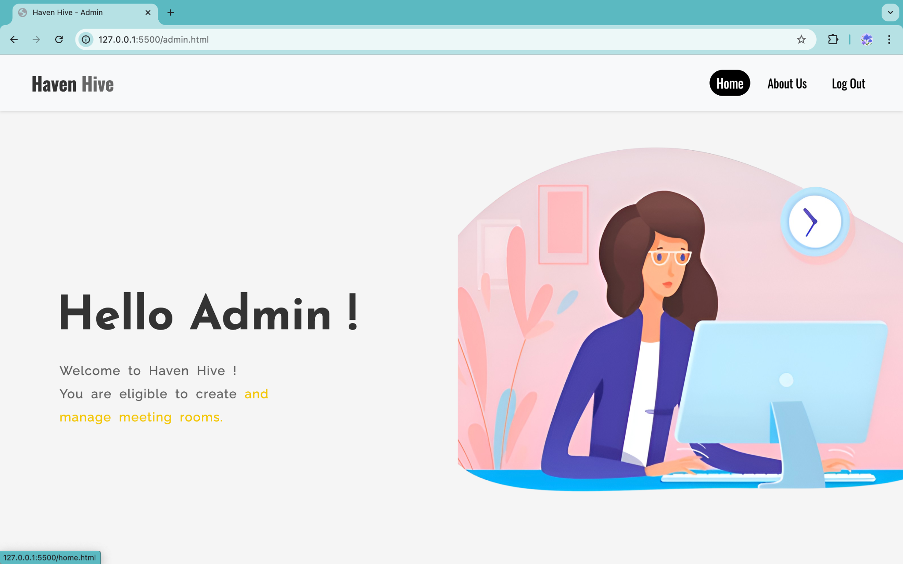
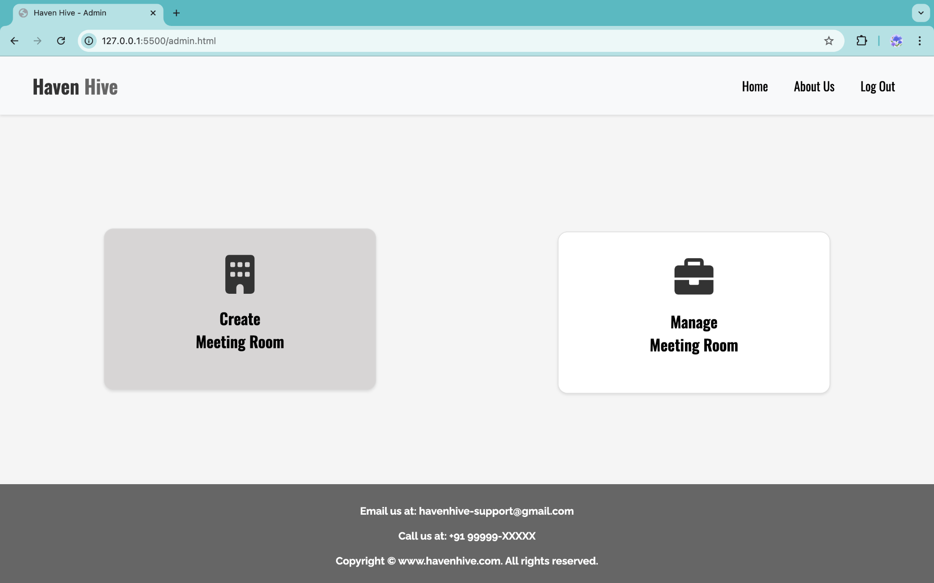
ADMIN PAGE
Admin Dashboard
Create Meeting: Add/remove meeting rooms, Manager and Users
Manage Meeting: Edit or delete existing rooms and manage amenities.

Slide 9

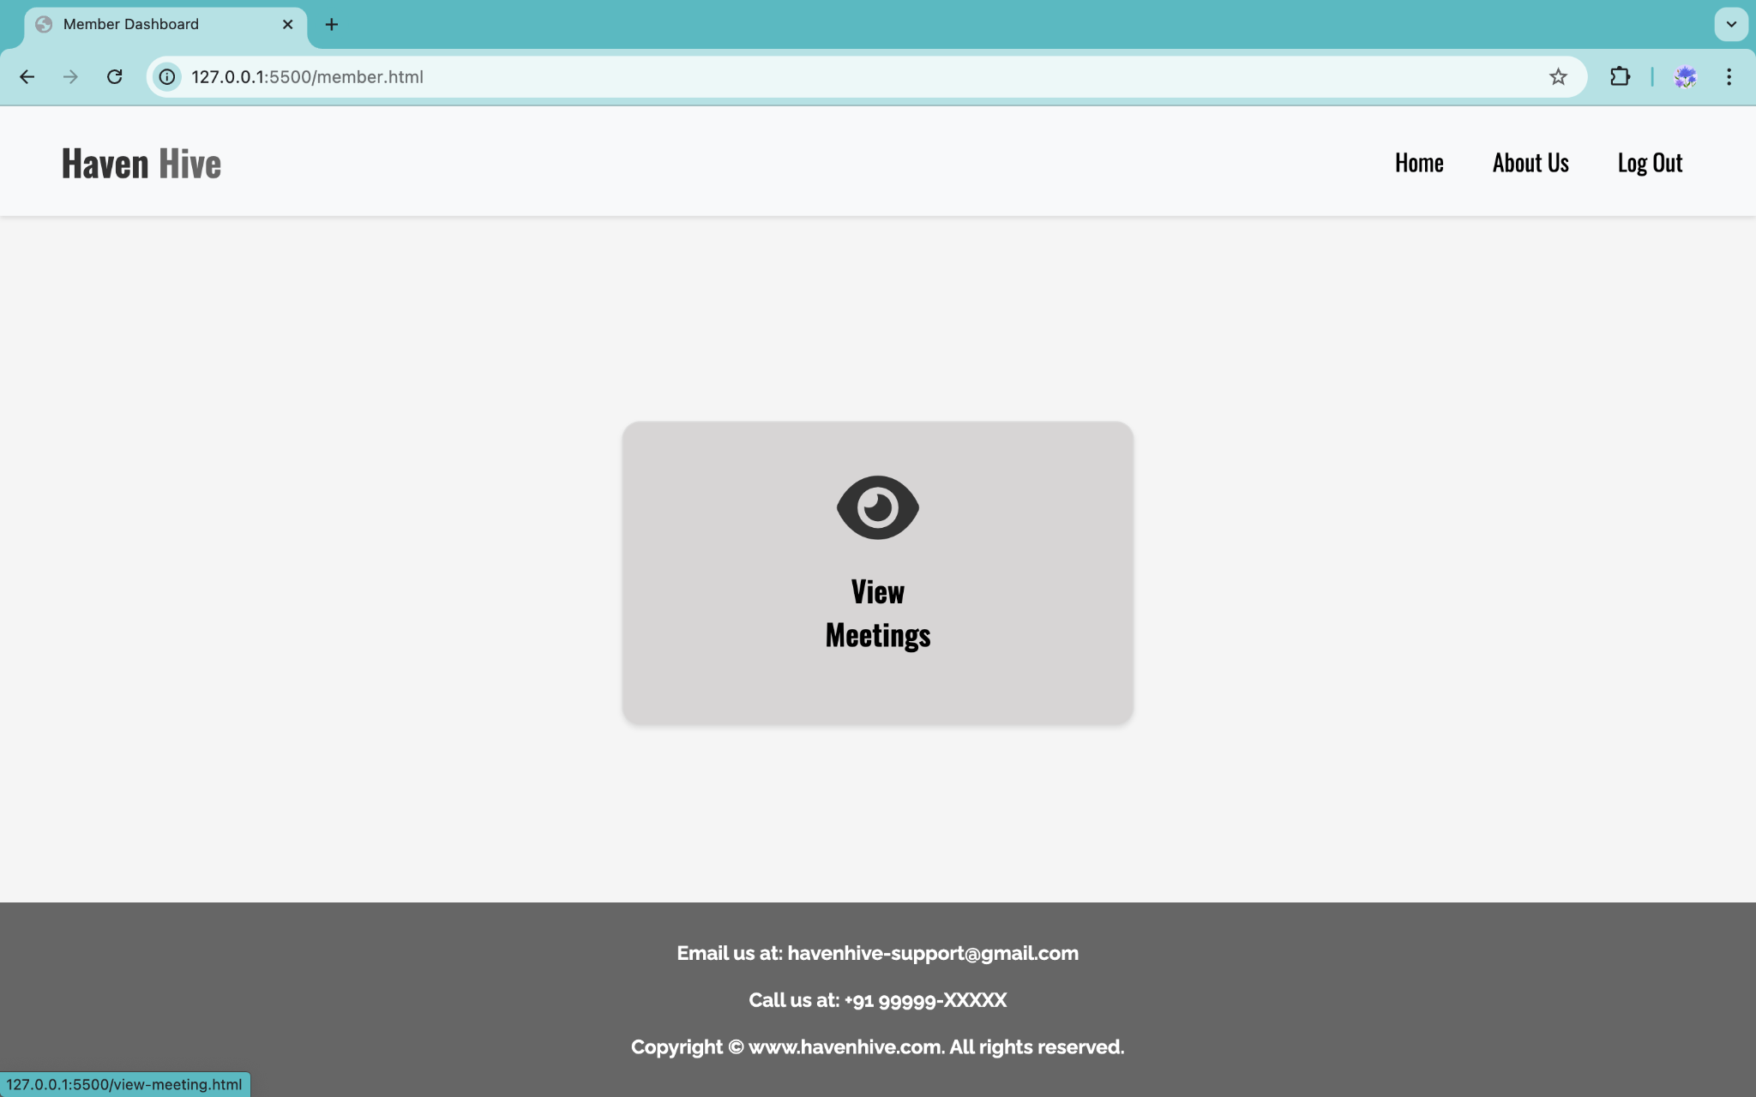
MEMBER PAGE
Member Dashboard
View Meeting: Add new meeting rooms with customized settings

Slide 10
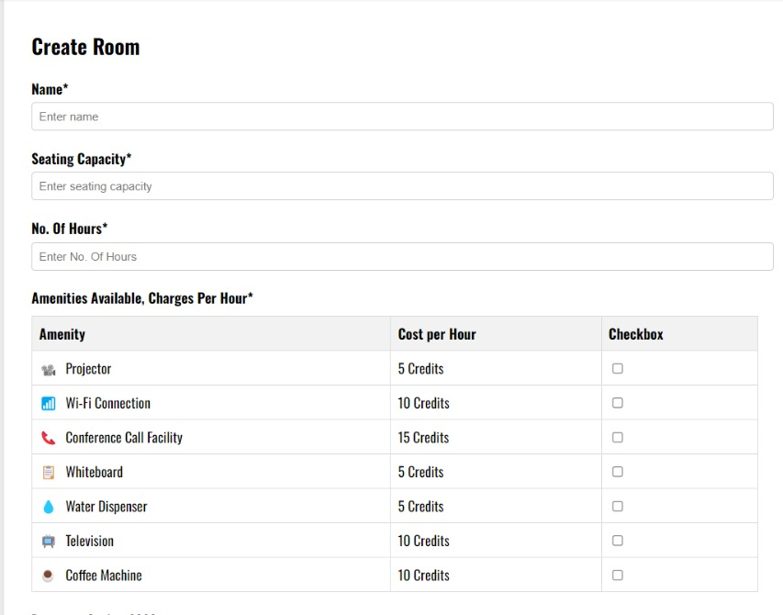
CREATE ROOM
Purpose: Admins can add new meeting rooms.
Details: Configure seating capacity, select amenities, and set room availability.

Slide 11
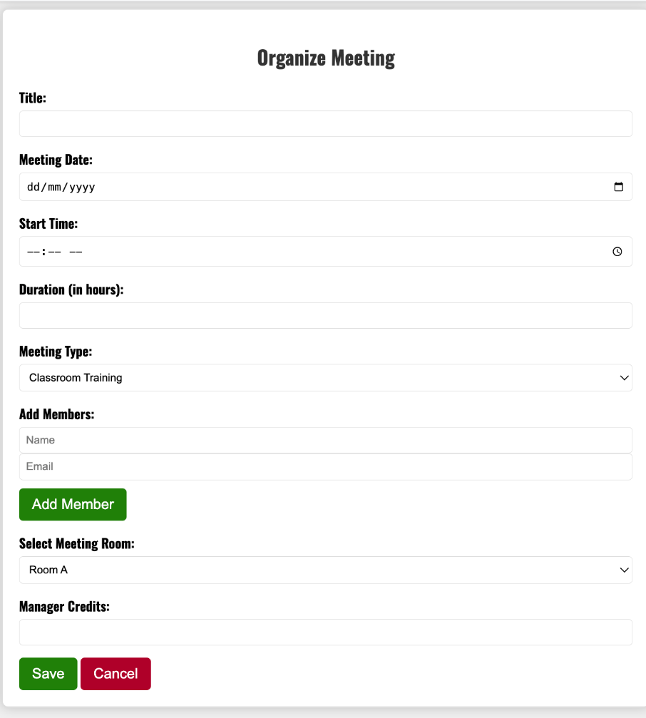
ORGANIZE MEETING
Managers can set up new meetings by selecting a date, time, and room.
Mandatory amenities based on meeting type (e.g., conference call, online training) are automatically selected.
Credits are automatically calculated based on the room and amenities.

Slide 12
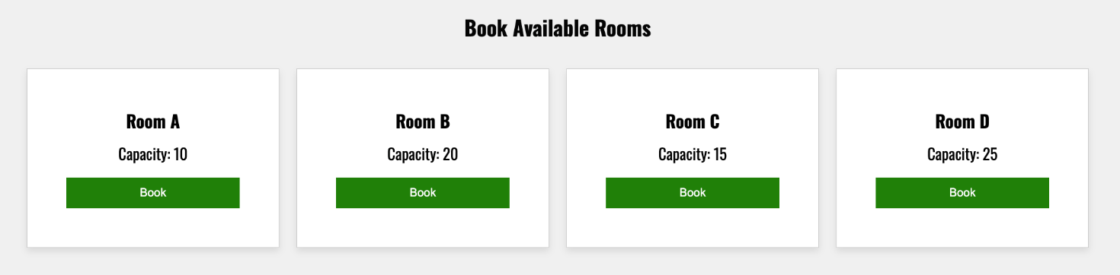
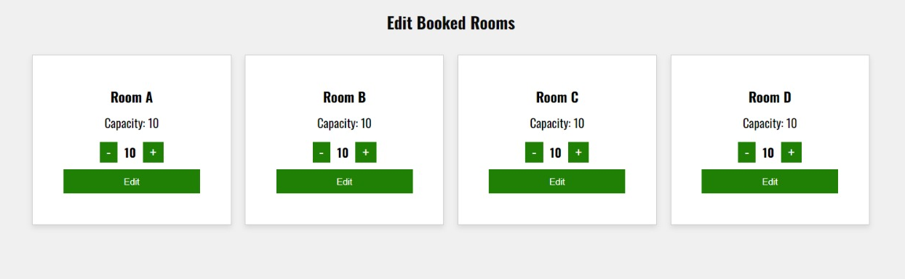
BOOK MEETING AND EDIT MEETING
Managers can book rooms based on seating capacity and also edit them

Slide 13
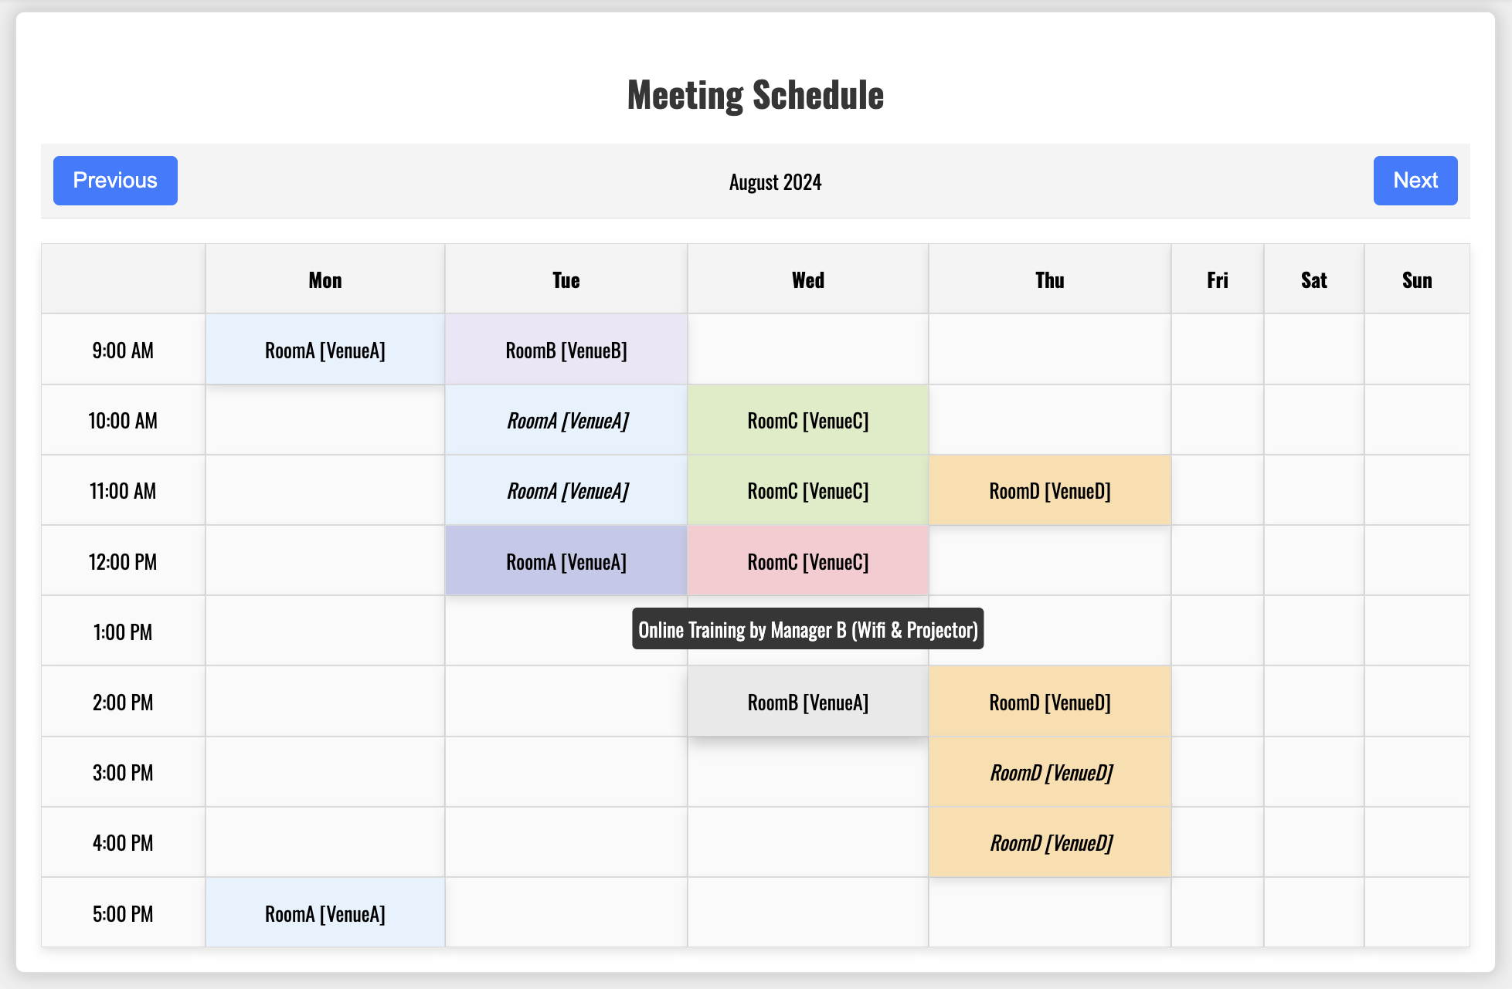
VIEW MEETING
Members can view the meeting schedule and also other details about the meetings.

Slide 14
Thanks!

